Slide 1
METIS DATA SCIENCE · PROJECT 03
Stack Overflow
Tag Prediction
A multi-label NLP classifier that predicts a question's tag set from its title alone — trained on a 400 GB MS SQL Server backup, evaluated across 100 tags.
Garreth Cline · Metis Data Science Bootcamp
25,352 questions · 100 tags · Jaccard = 47.76 · Hamming = 1.02 · 18.6× baseline

Slide 2
STACK OVERFLOW TAG PREDICTION // EXECUTIVE SUMMARY
02 / 13
TL;DR
A 400 GB database, one NLP pipeline, 100 predicted tags.
THE QUESTION
THE DATA
THE MODEL
THE RESULT
Can we predict which of 100 common tags belong to a Stack Overflow question using only the title?
400 GB MS SQL dump → 1M rows → filtered to 25,352 high-quality questions; 82,516 tag usages, 6,884 unique.
TF-IDF titles → 12-classifier benchmark → LinearSVC + GridSearchCV (best C=1).
Jaccard = 47.76, Hamming = 1.02 — an 18.6× lift over the 2.57 dummy baseline. ~90 of 100 tags at F1 > 0.98.
PassiveAggressive posted a higher raw Jaccard (48.50) — but LinearSVC had the best Hamming loss and stability, so it was the model carried forward. Selection isn't just "max one metric."
Garreth Cline · Metis Data Science · Project 3

Slide 3
STACK OVERFLOW TAG PREDICTION // DATA ENGINEERING
03 / 13
From 400 GB to 25,352 rows
Server-side filtering before Python ever sees the data.
RAW DATABASE
SQL EXPORT
SCORE > 50
VIEWS > 10K
TOP-100 TAGS
400 GB
1,000,000
28,183
27,666
25,352
MS SQL Server
(Brent Ozar dump)
Posts with Title
Community-
validated
Popular questions
Final training set
Server-side cleanup
Memory engineering
Parallelism
T-SQL strips commas, HTML brackets, nulls before export — saves pulling 400 GB into pandas.
Split peaked at 132 GB RAM; pickle caching + OS paging file to handle it.
n_jobs=32 across the workstation; 100-fold GridSearchCV in minutes.
Garreth Cline · Metis Data Science · Project 3

Slide 4
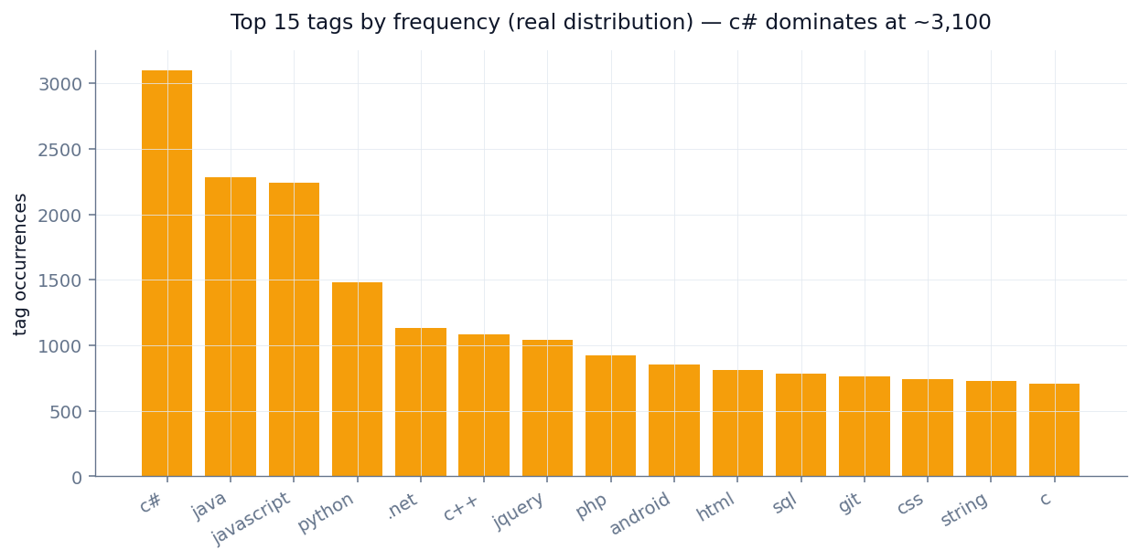
STACK OVERFLOW TAG PREDICTION // LABELS
04 / 13
Tag distribution is a brutal long tail
c# alone appears ~3,100 times; the top 100 cover ~82% of all usages.
Why top-100?
82,516 total tag usages across 6,884 unique tags — but the curve decays fast.
Beyond the top 100, tags have too few examples to learn reliably.
Top-100 captures ~82% of usages while keeping every label well-populated.
Garreth Cline · Metis Data Science · Project 3

Slide 5
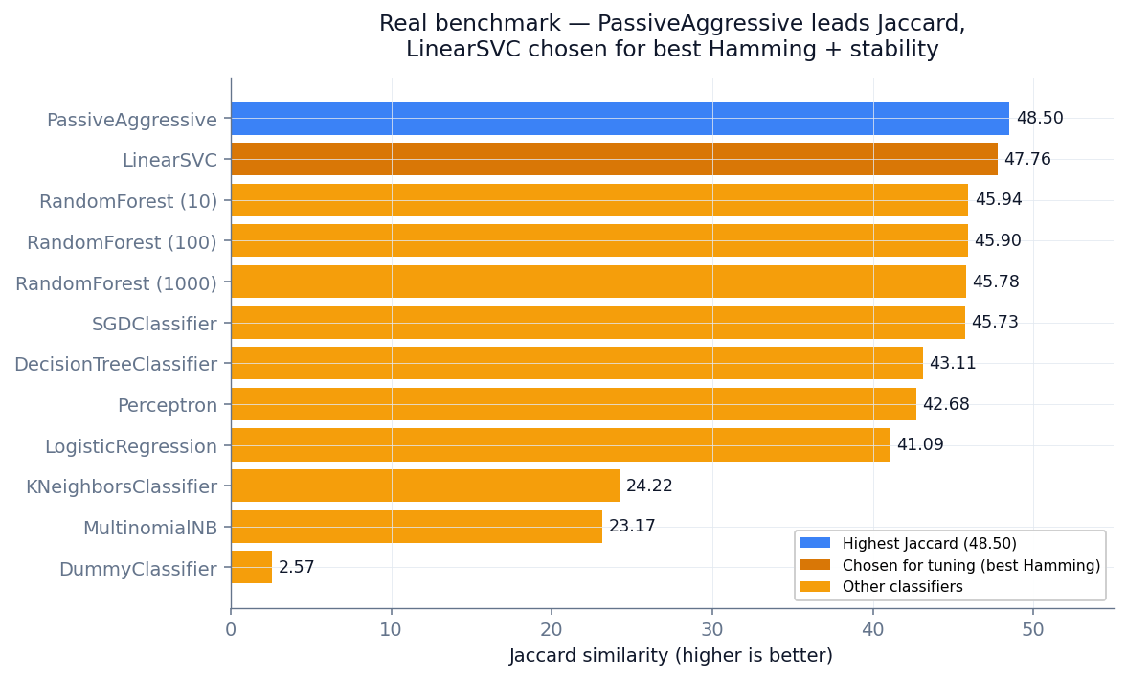
STACK OVERFLOW TAG PREDICTION // BENCHMARK
05 / 13
12 classifiers — the real ranking
PassiveAggressive leads Jaccard; LinearSVC second and far steadier.
Three findings
Linear models lead — PassiveAggressive (48.50), LinearSVC (47.76), SGD (45.73). Right inductive bias for TF-IDF.
More trees did nothing — all three Random Forests cluster at ~45.8. No interaction structure for an ensemble.
KNN (24.22) and Naive Bayes (23.17) lag — distance breaks down in sparse space; independence assumption fails.
Garreth Cline · Metis Data Science · Project 3

Slide 6
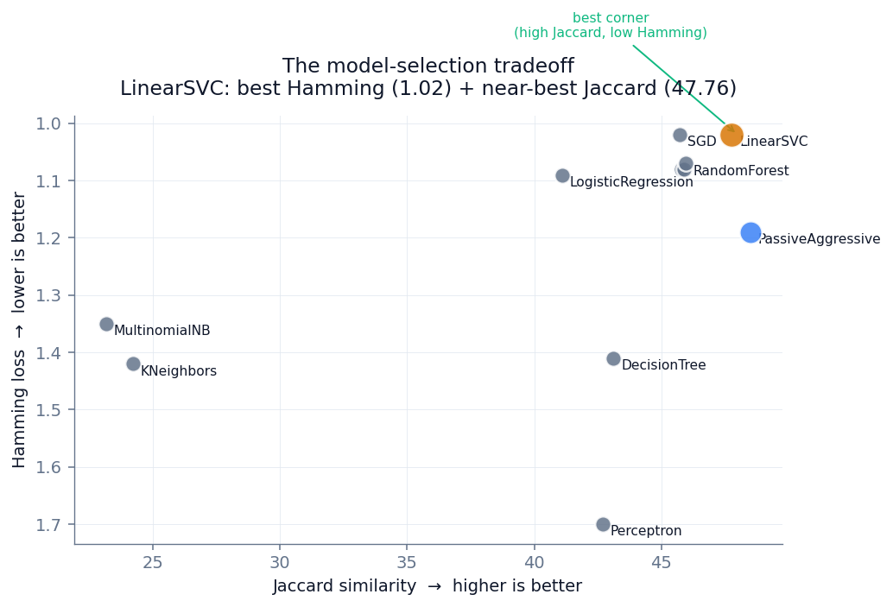
STACK OVERFLOW TAG PREDICTION // MODEL SELECTION
06 / 13
Why LinearSVC, not the higher-Jaccard model?
Reading two metrics at once — the honest selection story.
The tradeoff
PassiveAggressive wins raw Jaccard (48.50) but pays in Hamming loss (1.19). LinearSVC sits in the best corner — top-tier on BOTH axes (Jaccard 47.76, Hamming 1.02). Stability: PassiveAggressive's online-update rule makes it erratic run-to-run. LinearSVC is reproducible. Trading 0.74 Jaccard points for a materially better Hamming loss and reproducibility is the defensible call.
Garreth Cline · Metis Data Science · Project 3

Slide 7
STACK OVERFLOW TAG PREDICTION // RESULTS
07 / 13
Tuned LinearSVC on held-out test set
GridSearchCV found best C=1; final real numbers below.
JACCARD
HAMMING LOSS
47.76
1.02
18.6× the dummy baseline (2.57)
~1% of the 100-tag matrix mislabeled
F1 > 0.98
WEAKEST TAG
~90 of 100
0.94
Tags essentially solved
`.net` — 25.5% positive-class recall
Garreth Cline · Metis Data Science · Project 3

Slide 8
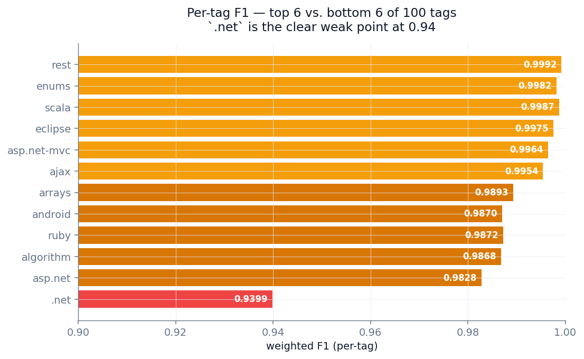
STACK OVERFLOW TAG PREDICTION // PER-TAG PERFORMANCE
08 / 13
~90 of 100 tags essentially solved
Real per-tag weighted F1 — top 6 vs. bottom 6.
The spread
Strongest: rest (0.9992), scala (0.9987), enums (0.9982) — narrow, unambiguous tags.
These tags have distinctive vocabulary that rarely overlaps with others.
The clear outlier: `.net` at 0.94 — the only tag below 0.98.
Garreth Cline · Metis Data Science · Project 3

Slide 9
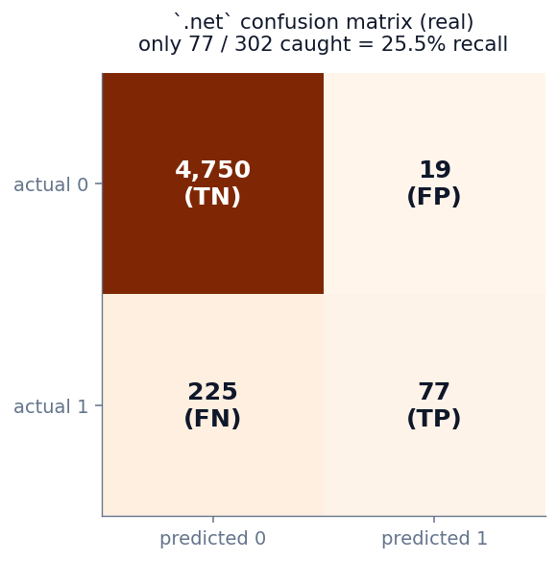
STACK OVERFLOW TAG PREDICTION // ERROR ANALYSIS
09 / 13
Why `.net` is the hardest tag
The real confusion matrix exposes a co-occurrence problem.
The problem
Of 302 actual `.net` questions, only 77 were caught — 25.5% positive-class recall. Its weighted F1 of 0.94 is inflated by 4,750 true negatives — the honest number is the recall. Why? `.net` almost never appears alone in a title. It co-occurs with c#, vb.net, asp.net, wpf, linq, wcf — and its own top features ARE linq, wcf, assembly, nullable. The binary classifier can't disambiguate on context the OvR wrapper hides. Fix: hierarchical labels — predict language family first, then `.net` as an implied parent.
Garreth Cline · Metis Data Science · Project 3

Slide 10
STACK OVERFLOW TAG PREDICTION // INTERPRETABILITY
10 / 13
The model rediscovered each tag's ecosystem
Real top title words per tag, from the SVC coefficients.
.net
android
algorithm
linq, delegate, nullable, wcf, forms, assembly, .net, net
device, layout, emulator, listview, intent, textview, webview, activity, android
detecting, finding, area, number, graph, binary, sort, tree, algorithm
ajax
asp.net
asp.net-mvc
underscore, fetch, json, request, google, status, prompt, ajax
ip, datatable, request, onclick, master, session, webconfig, asp.net, aspnet
item, render, repository, fire, aspnet, action, controller, partial, mvc
Each tag's learned vocabulary matches its real ecosystem — a sanity check that the model captured genuine patterns, not training-set quirks.

Slide 11
STACK OVERFLOW TAG PREDICTION // APPLICATIONS
11 / 13
Three ways this gets used
All viable at Jaccard 47.76, Hamming 1.02.
1
Auto-tagging imported archives
Migrating closed forum threads to a tagged knowledge base. Production-ready for the ~90 tags above F1 0.98; human-in-the-loop for .net / c# / c++.
2
Tag-suggestion UI
Autosuggest widget firing on each keystroke as a user types a question title. Top-k predictions become clickable chips.
3
Moderation signal
Flag questions whose author-assigned tags disagree with the model. The model learned canonical patterns from 25K high-quality examples.
Garreth Cline · Metis Data Science · Project 3

Slide 12
STACK OVERFLOW TAG PREDICTION // CAVEATS
12 / 13
What's missing, and where V2 goes
Honest limitations and prioritized future work.
LIMITATIONS
FUTURE WORK
Title-only input — bodies (error messages, library names) would disambiguate the co-occurring tags.
Add post Body via BeautifulSoup — biggest gains on co-occurring tags.
Top-100 tags = ~82% of usages, not 100% — the 6,784-tag long tail is out of scope.
Swap TF-IDF for CodeBERT / StarCoder embeddings — code-aware.
2010 snapshot — kotlin, rust, tensorflow, react weren't yet prominent.
Hierarchical labels — language family first, then fine-grained tags.
Weighted F1 flatters rare tags — per-positive-class recall (the .net 25.5%) is the honest lens.
Per-tag decision-threshold tuning — would lift .net recall directly.
Garreth Cline · Metis Data Science · Project 3

Slide 13
STACK OVERFLOW TAG PREDICTION // BOTTOM LINE
13 / 13
The bottom line
A linear model on TF-IDF titles predicts 100 Stack Overflow tags at Jaccard 47.76 / Hamming 1.02 — ~90 of 100 tags solved, on a fraction of the compute a transformer would need.
What this demonstrates
Data engineering
400 GB MS SQL Server backup; T-SQL export automation; 132 GB-peak memory management.
Model judgment
Chose LinearSVC over a higher-Jaccard model by reading Hamming + stability together.
Honest analysis
Surfaced the .net weak spot (25.5% recall) and designed a hierarchical fix — not just "more data."
STACK
Python · pandas · scikit-learn · NLTK · pyarrow · Dask · MS SQL Server · T-SQL · matplotlib

